Slide 1
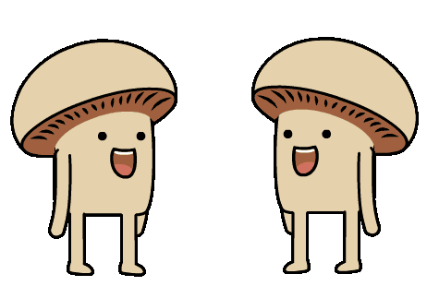





*
Why fungi are the best friends you never knew you had
*and worst enemies
@RowenaCHill

Slide 2
What are fungi?
@RowenaCHill

Slide 3
@RowenaCHill

Slide 4
They’re so diverse
@RowenaCHill

Slide 5
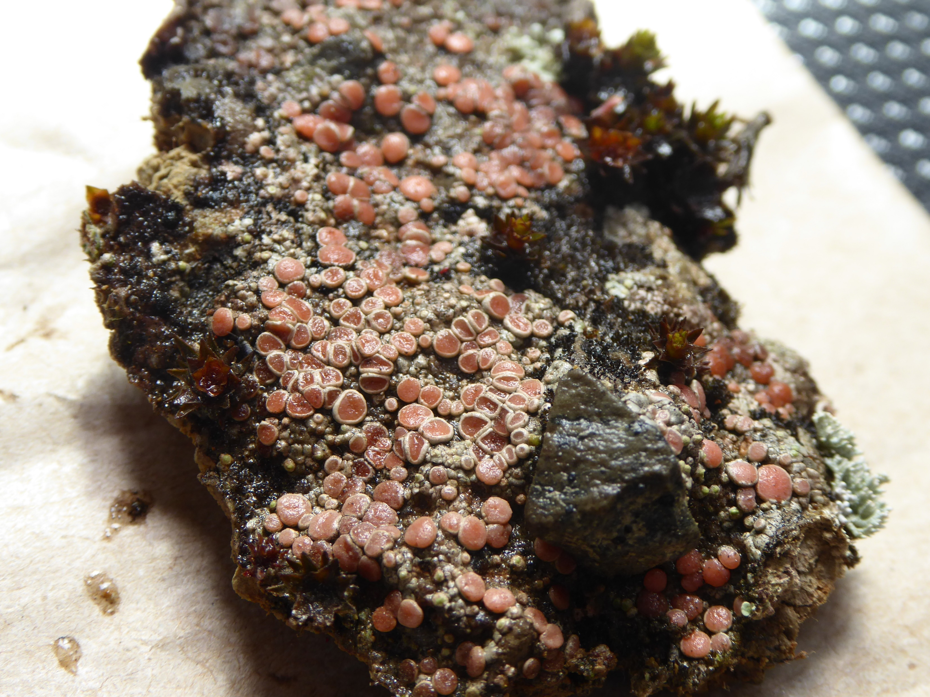
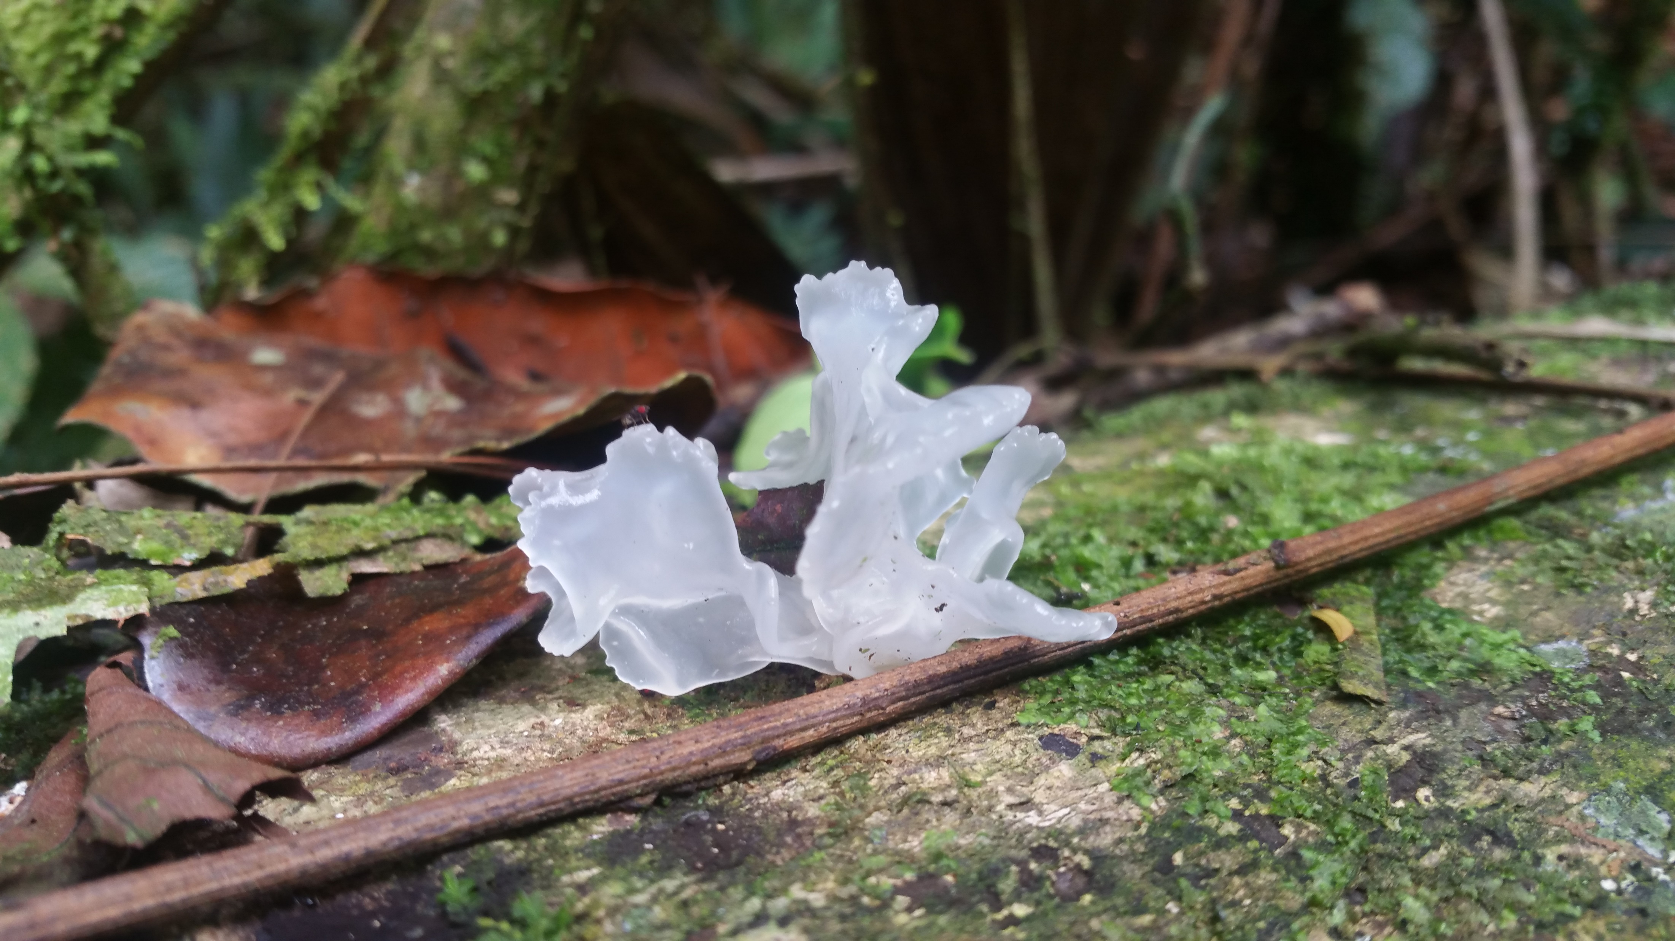
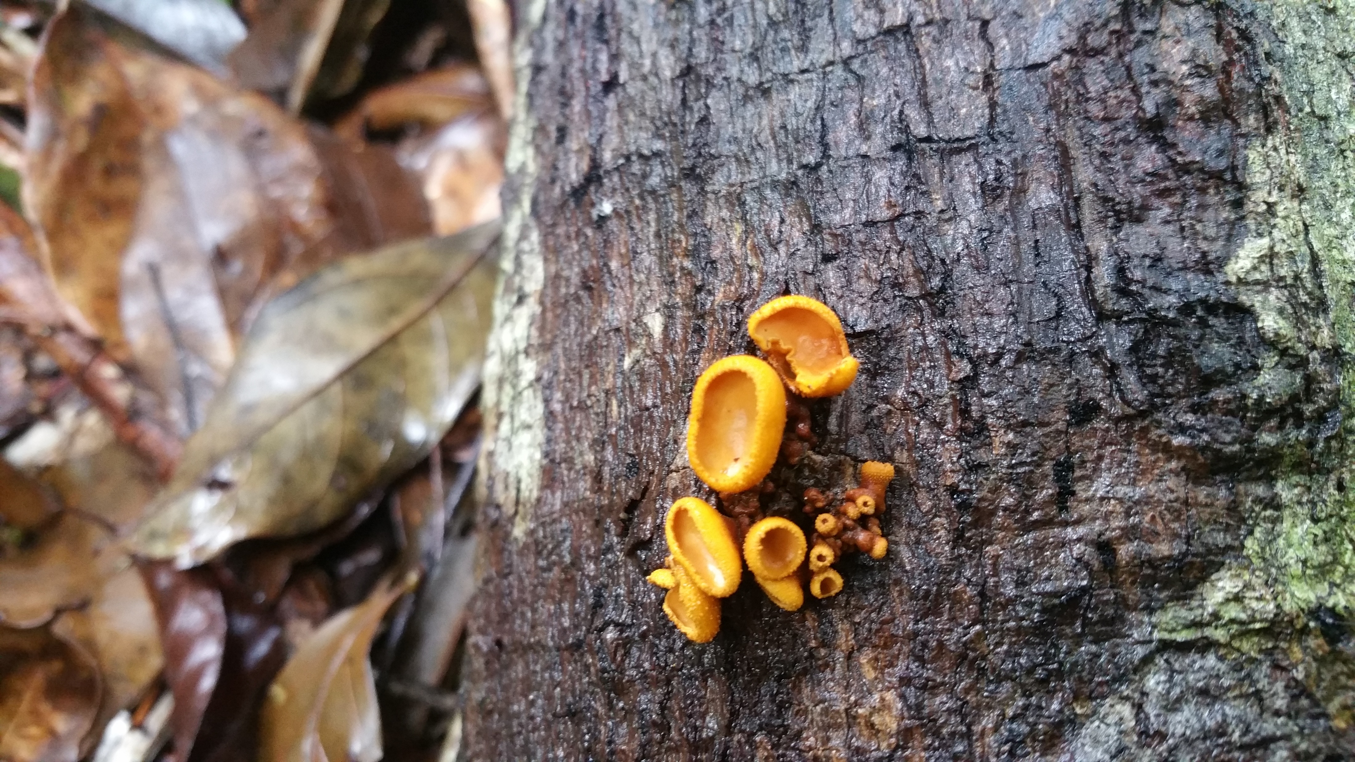
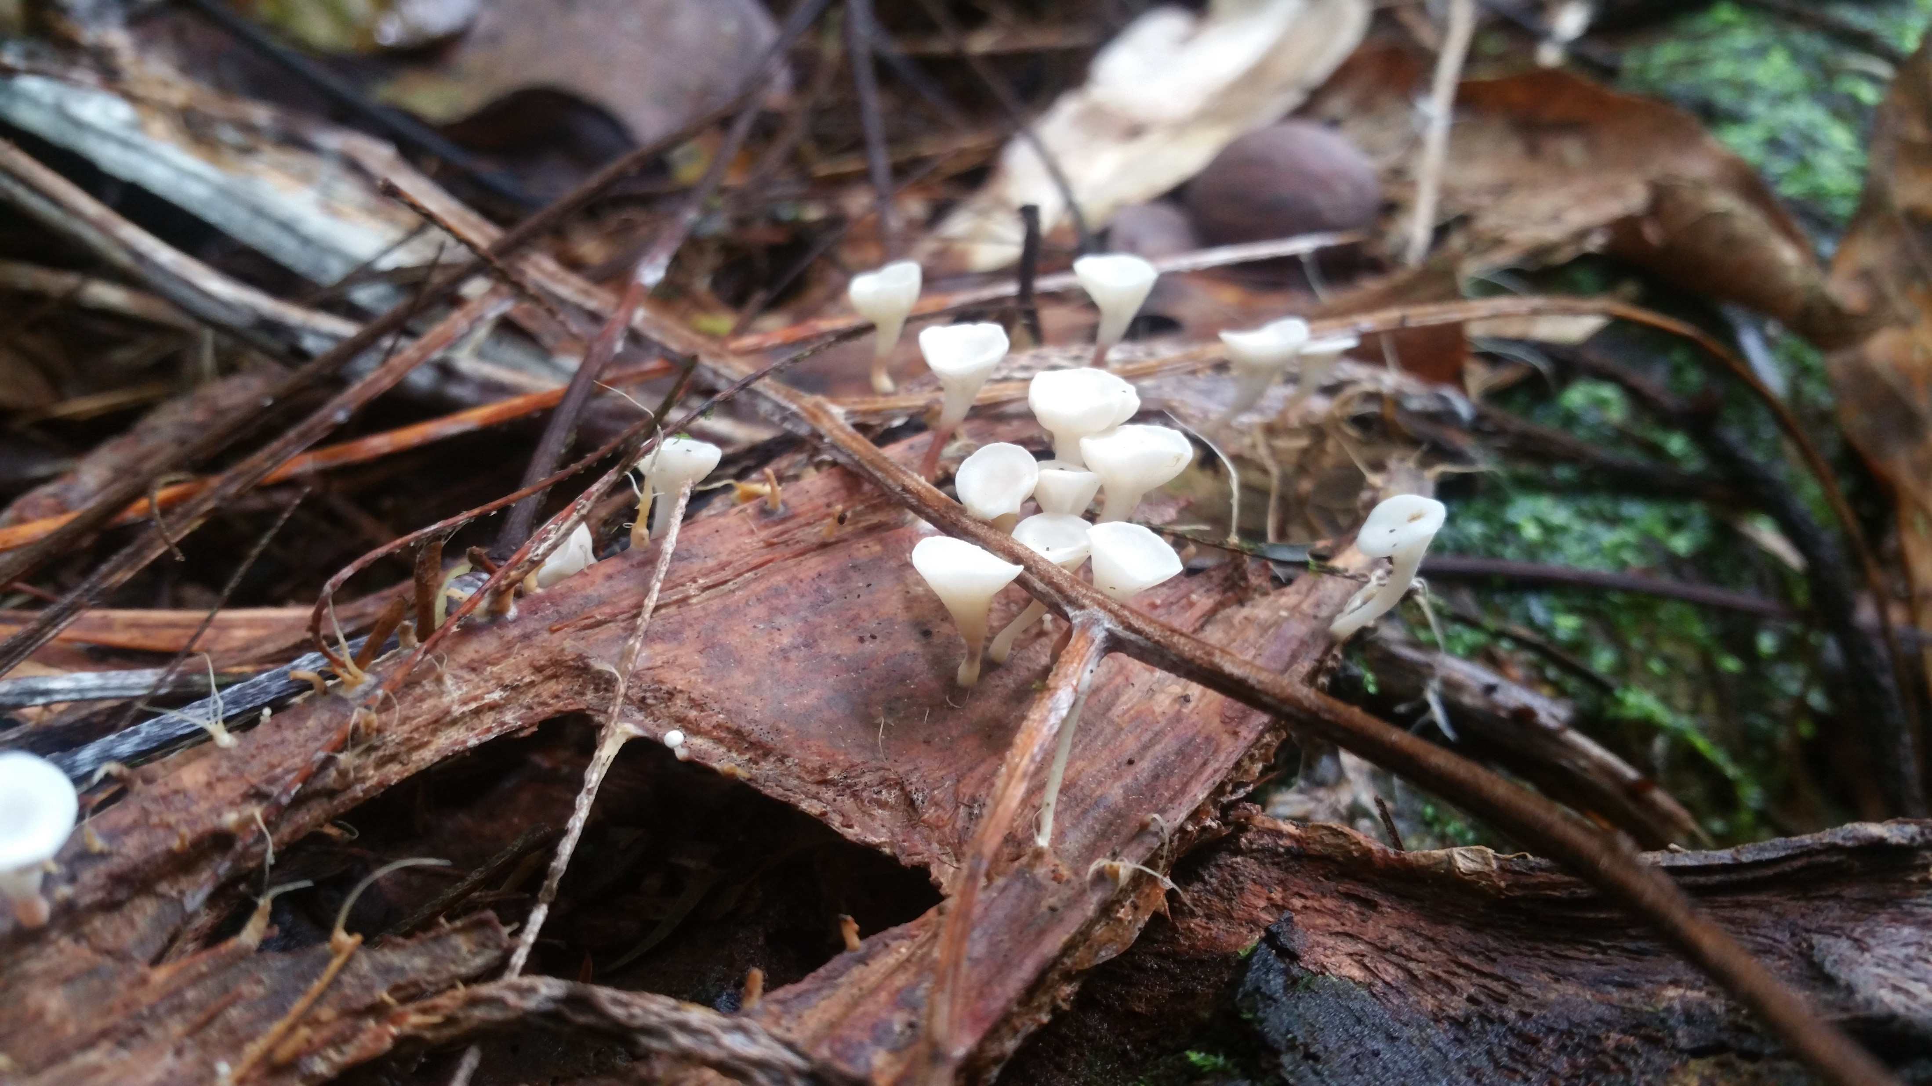
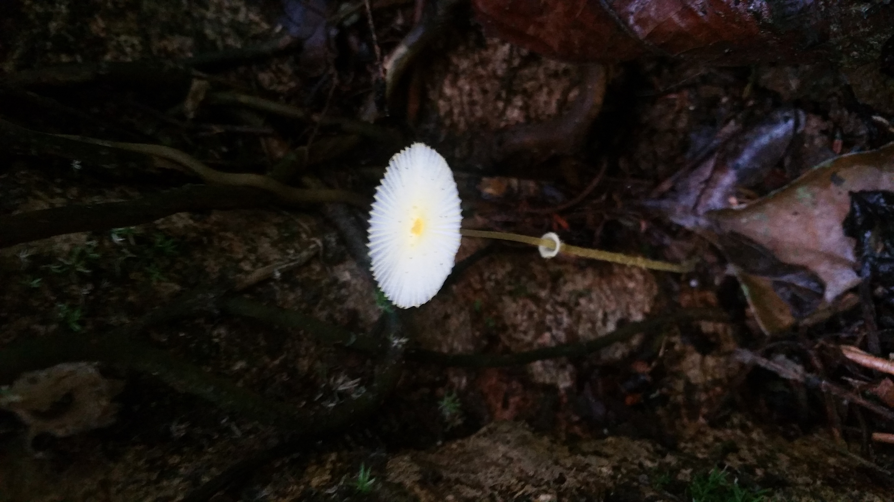
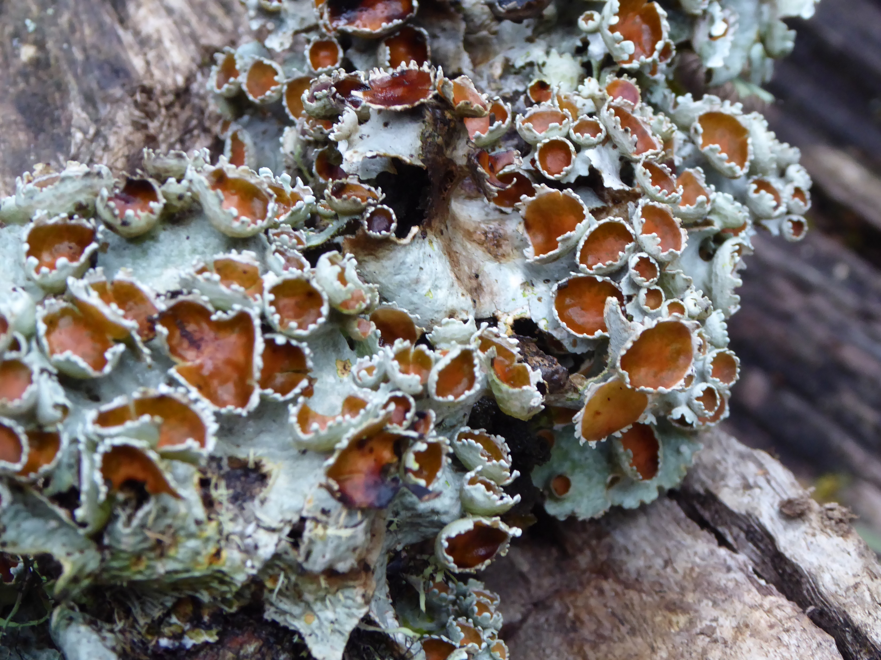
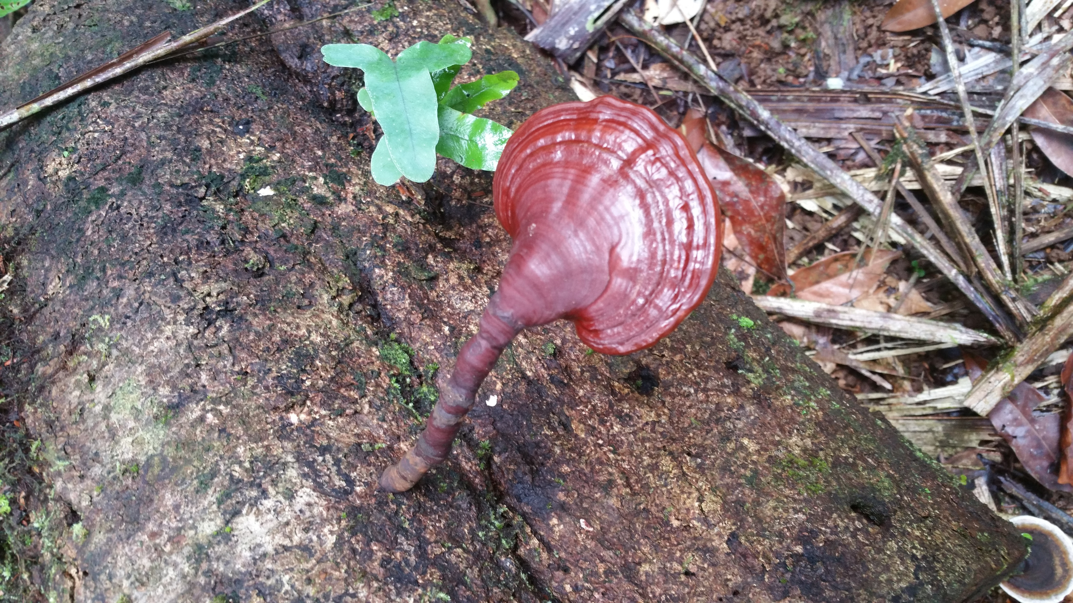
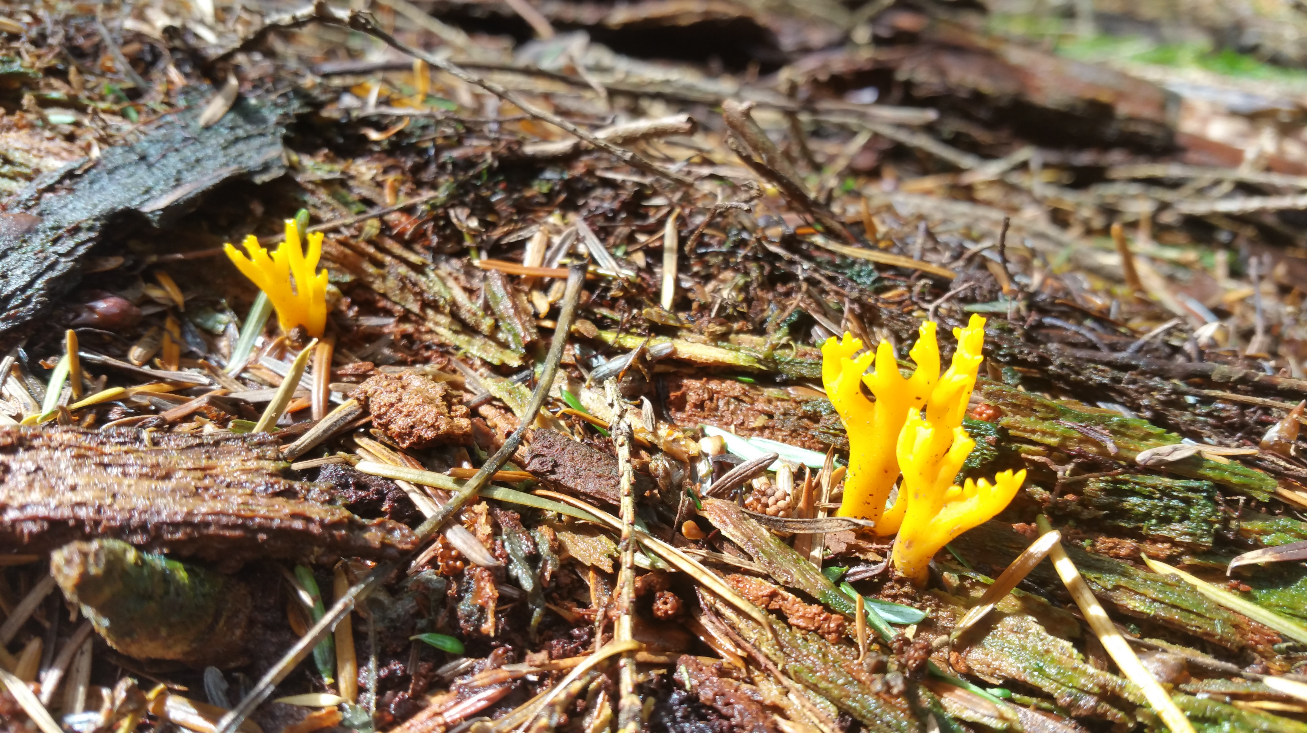
They’re so diverse
@RowenaCHill

Slide 6
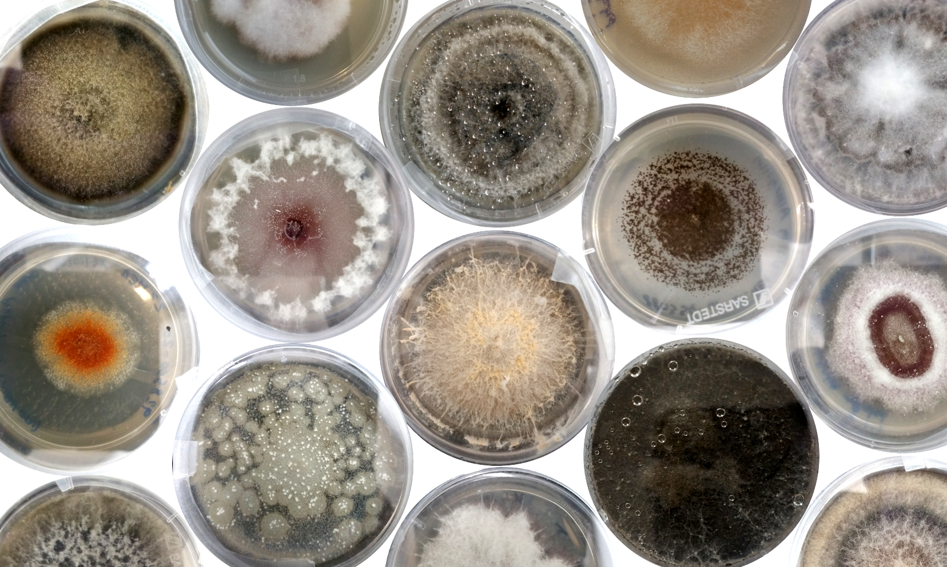
@RowenaCHill

Slide 7
They’re so diverse
@RowenaCHill

Slide 8

They’re so diverse
@RowenaCHill

Slide 9

They’re indispensable to us
Biofuels
Leather and cotton processing
Soy sauce and miso
Alcohol
Dairy
Manufacturing and industry
Edible fungi
Food
Plastics and biomaterials
Paper manufacturing
Breadmaking
Meat substitutes
Washing detergents
Statins
Medicine
Bioremediation
Psychedelics
Immunosuppressants
Environmental management
Antibiotics
Agricultural biocontrol
@RowenaCHill

Slide 10
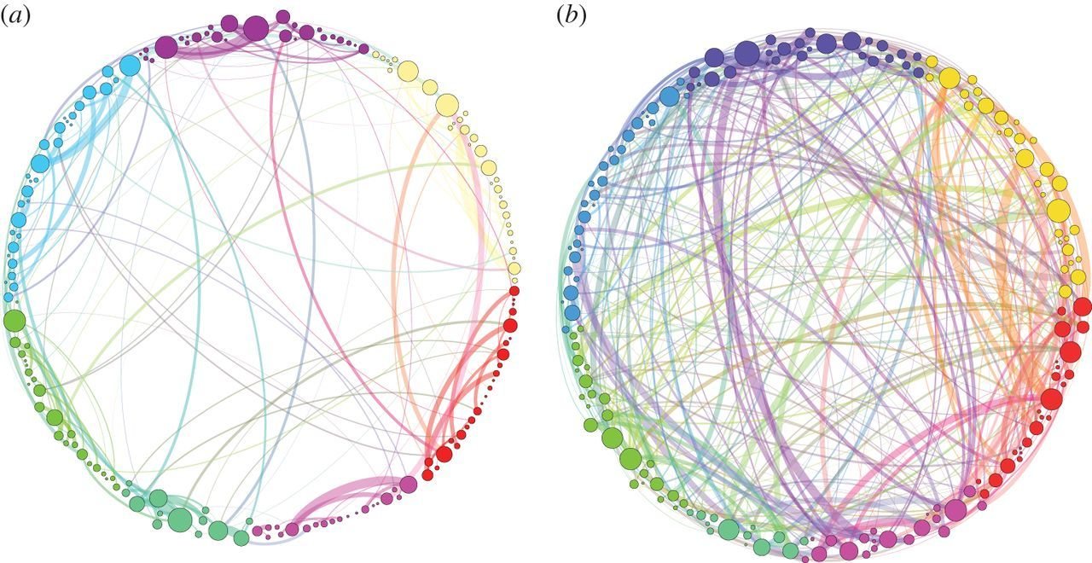
Petri et al. 2014
@RowenaCHill

Slide 11

Petri et al. 2014
@RowenaCHill

Slide 12
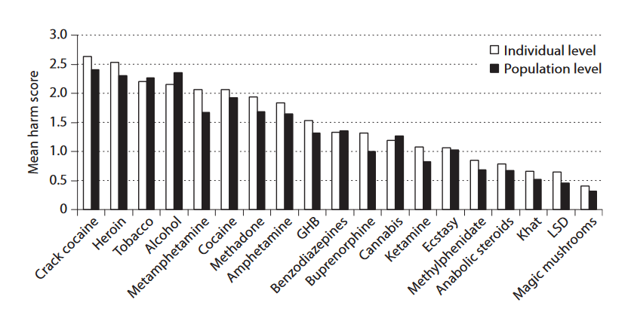

van Amsterdam et al. 2010
@RowenaCHill

Slide 13
They’re everywhere and interact with everything
Plants
Water
Animals
Permafrost
Soil
Rocks
Air
@RowenaCHill

Slide 14
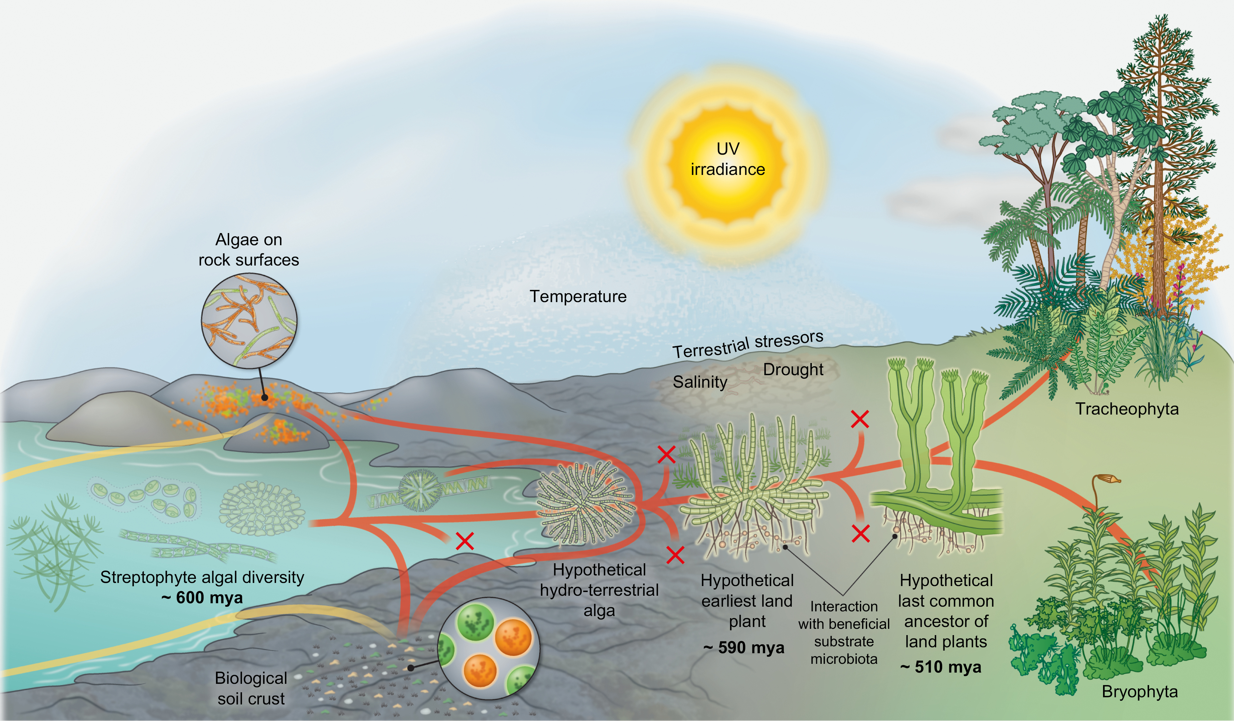

@RowenaCHill
Fürst-Jansen et al. (2020)

Slide 15

Clemmensen et al. (2013)
“…most of the stored carbon in boreal forested islands in Sweden is in fact derived from mycorrhizal mycelium rather than from plant litter.”
@RowenaCHill

Slide 16
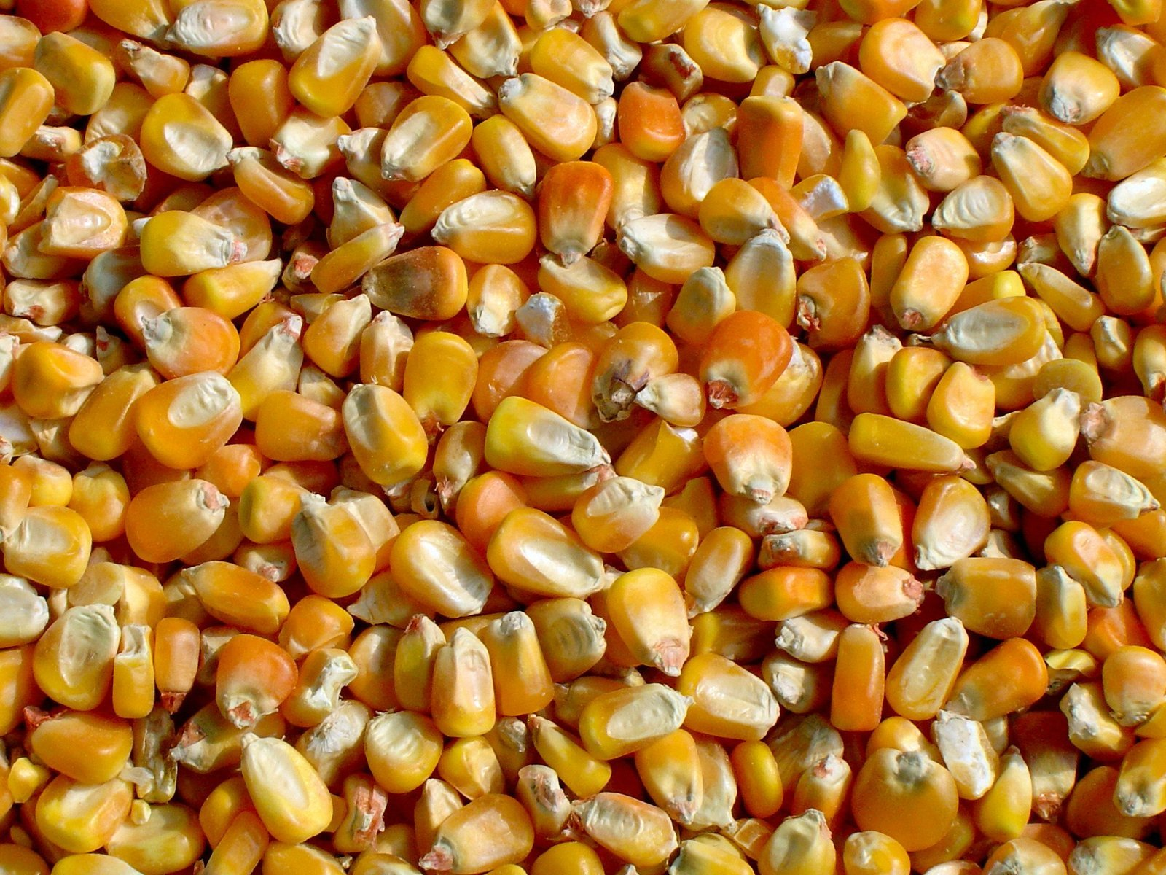
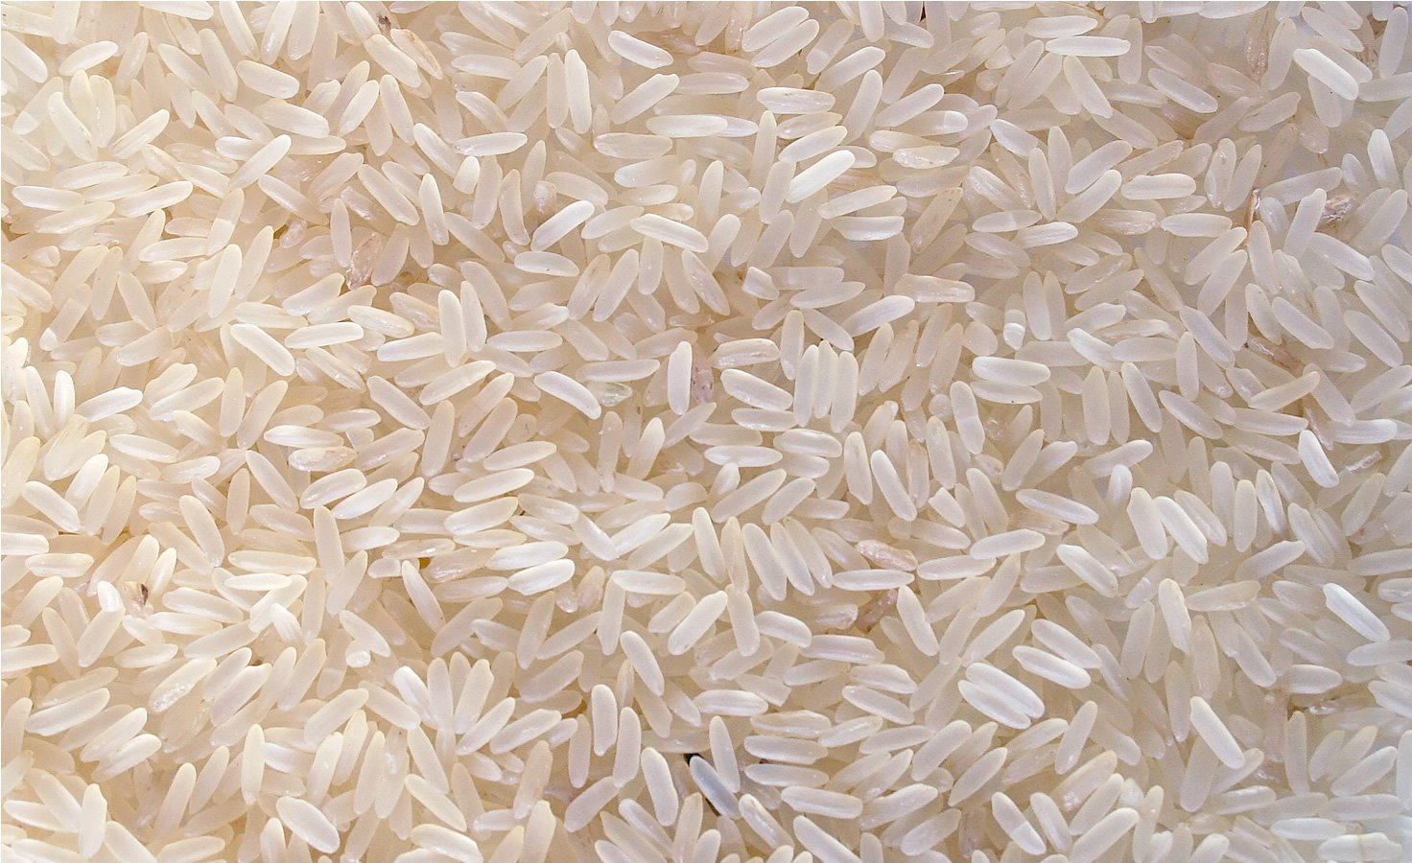
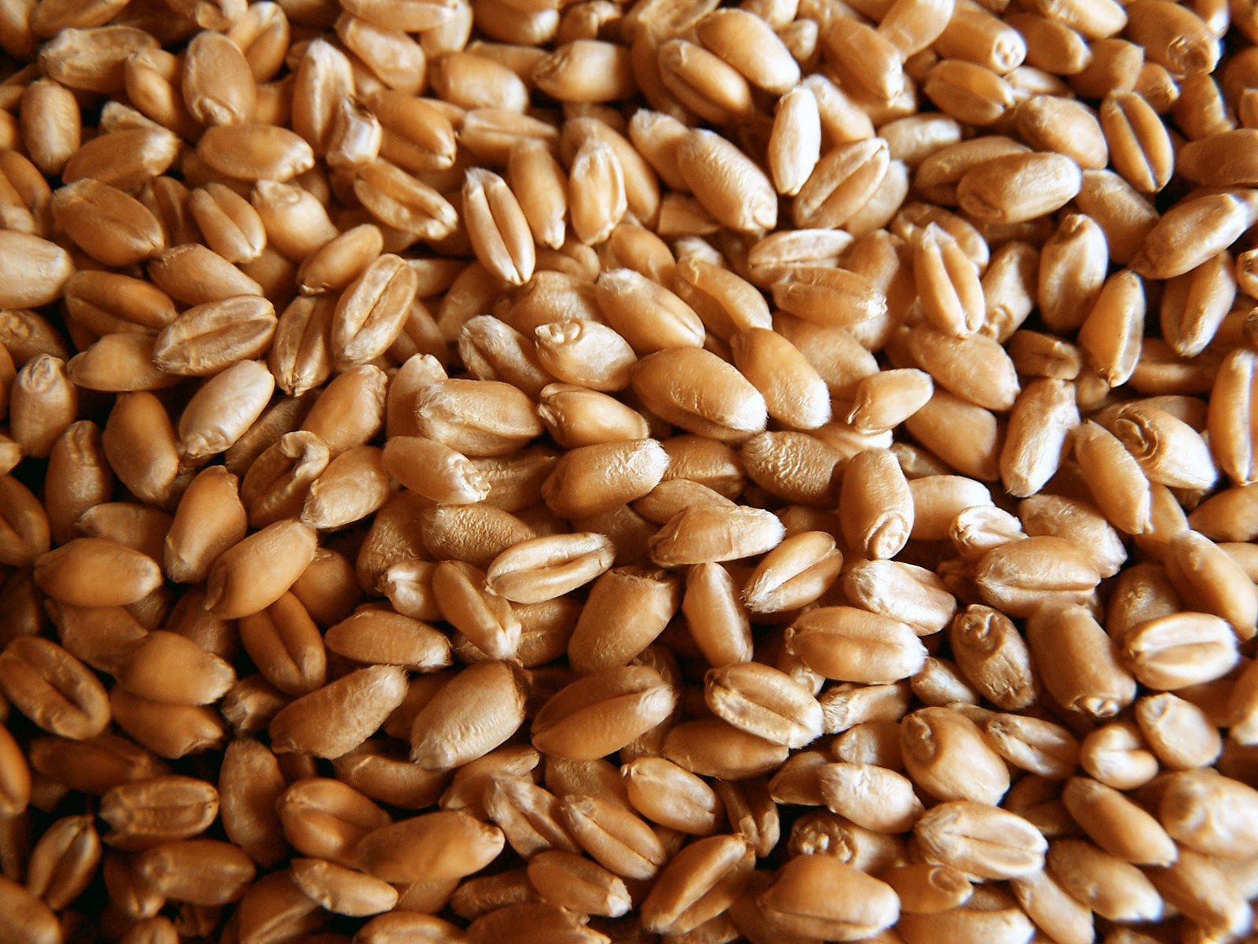
If we want to talk about a battle…
10-70%
10-35%
10-70%
Fisher et al. (2012)
@RowenaCHill

Slide 17
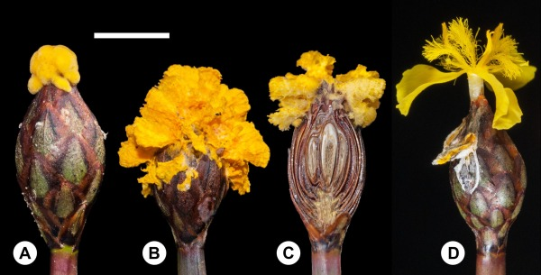
Laraba et al. (2020)
@RowenaCHill

Slide 18

@RowenaCHill

Slide 19


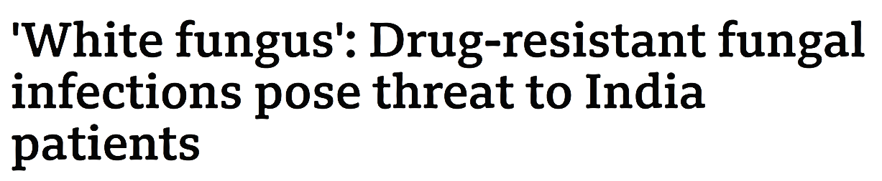

@RowenaCHill

Slide 20
To summarise:
They are hyperdiverse, weird and cool
They are delicious (willing to disagree on this) and useful (non-negotiable!)
They literally helped plants become plants
(and maybe mammals become mammals)
They are the ultimate recyclers
They also kick some serious plant and animal butt (sorry plants and animals)
1
@RowenaCHill

Slide 21
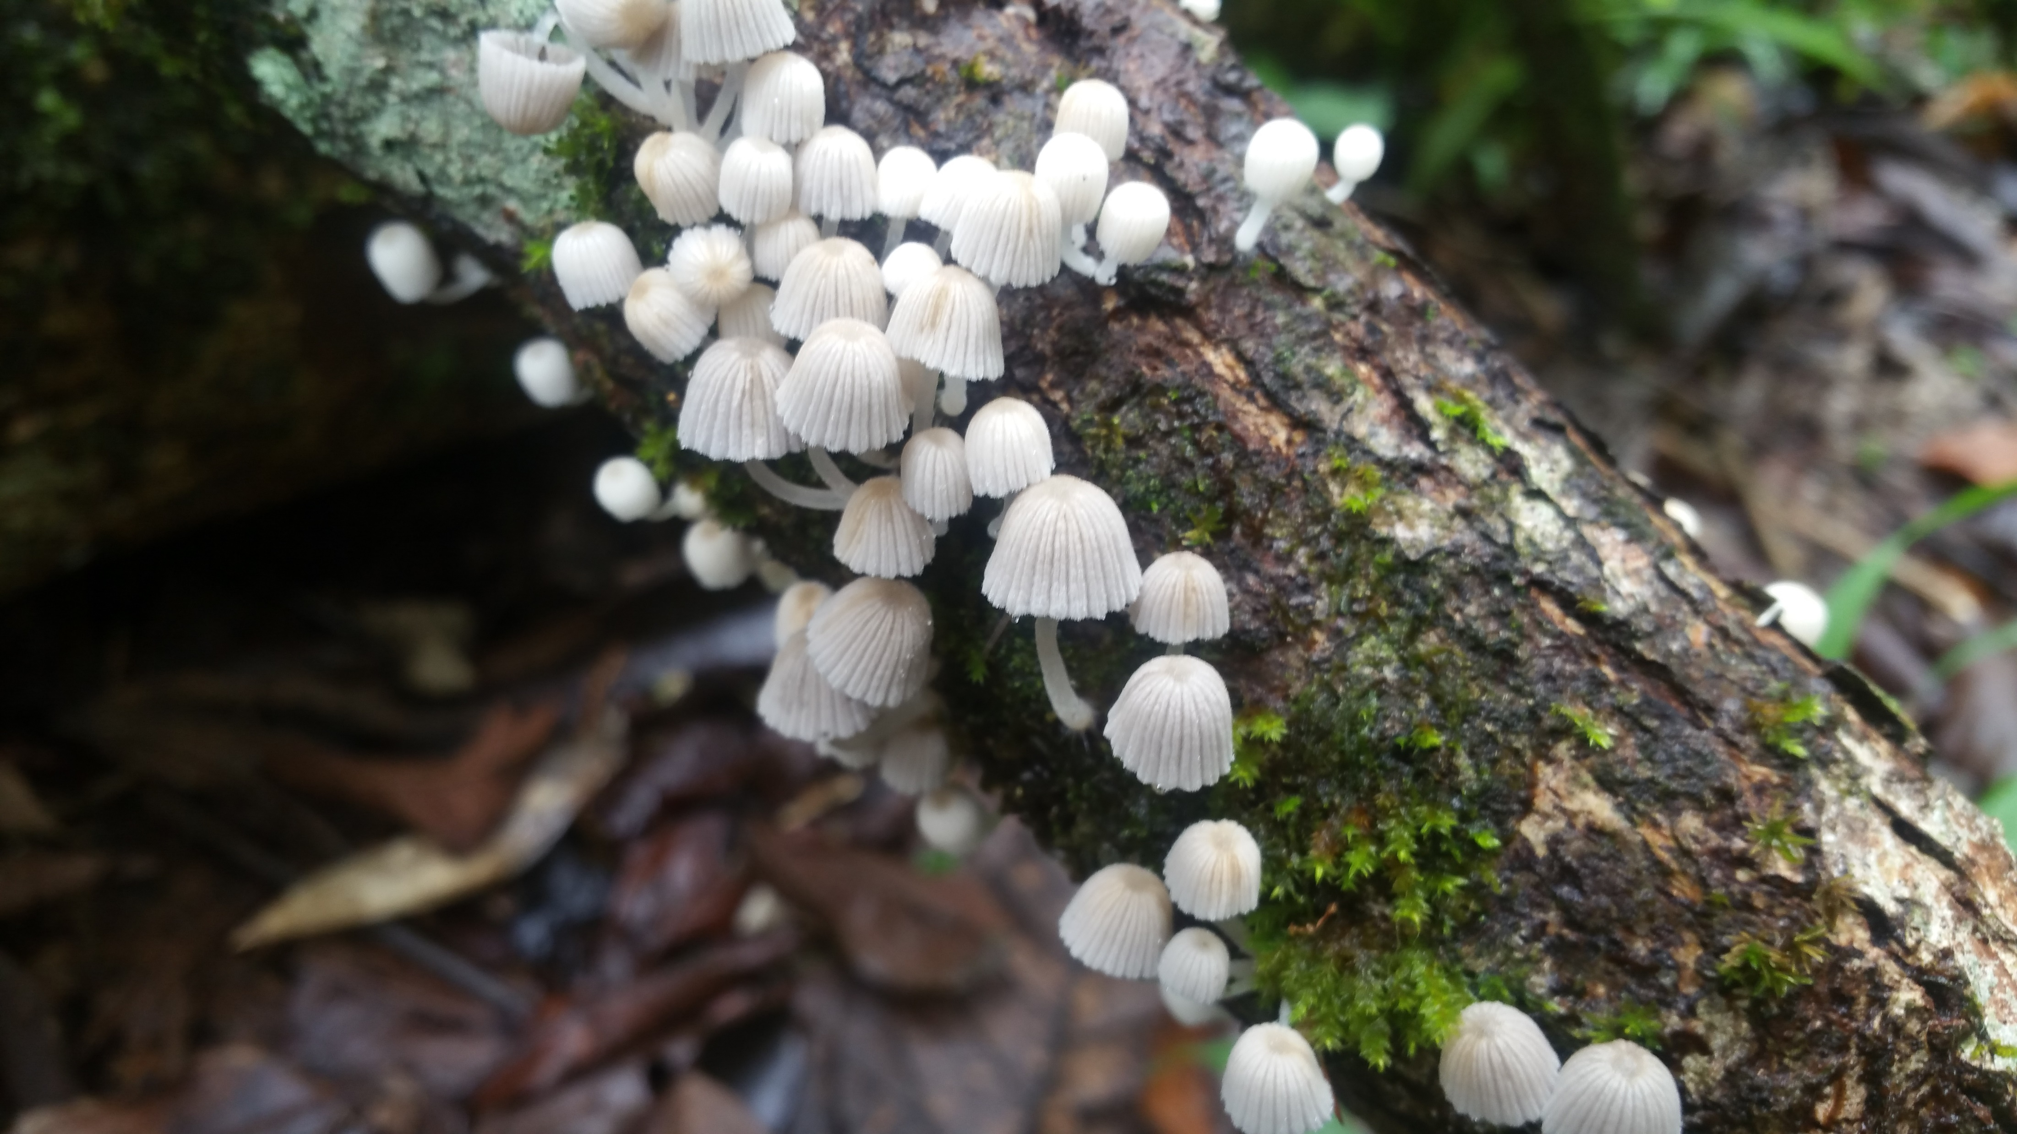

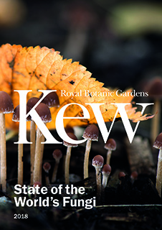


github.com/Rowena-h/Presentations
@RowenaCHill
stateoftheworldsfungi.org
Thanks for listening!
@mushroommovieee for all the superlative gifs!

